Slide 1
Chapter 8.4
MATH 1550 - Precalculus

Slide 2


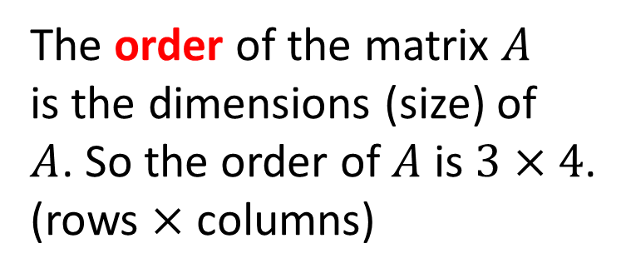
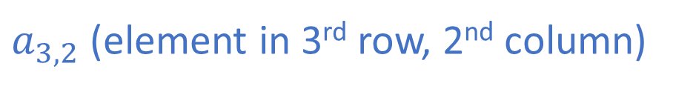
What is a Matrix?
A matrix is a rectangular table of numbers written in brackets as a convenient way to express data:
4 columns
The order of the matrix $A$ is the dimensions (size) of $A$. So the order of $A$ is $3×4$. (rows $×$ columns)
$$\left[\begin{matrix}8 & 6 & \begin{matrix}7 & 5\end{matrix} \\ 3 & 0 & \begin{matrix}9 & −4\end{matrix} \\ \sqrt{2} & 10 & \begin{matrix}1/3 & 2\end{matrix}\end{matrix}\right]$$
3 rows
$$= A$$
$a_{3,2}$ (element in 3rd row, 2nd column)

Slide 3
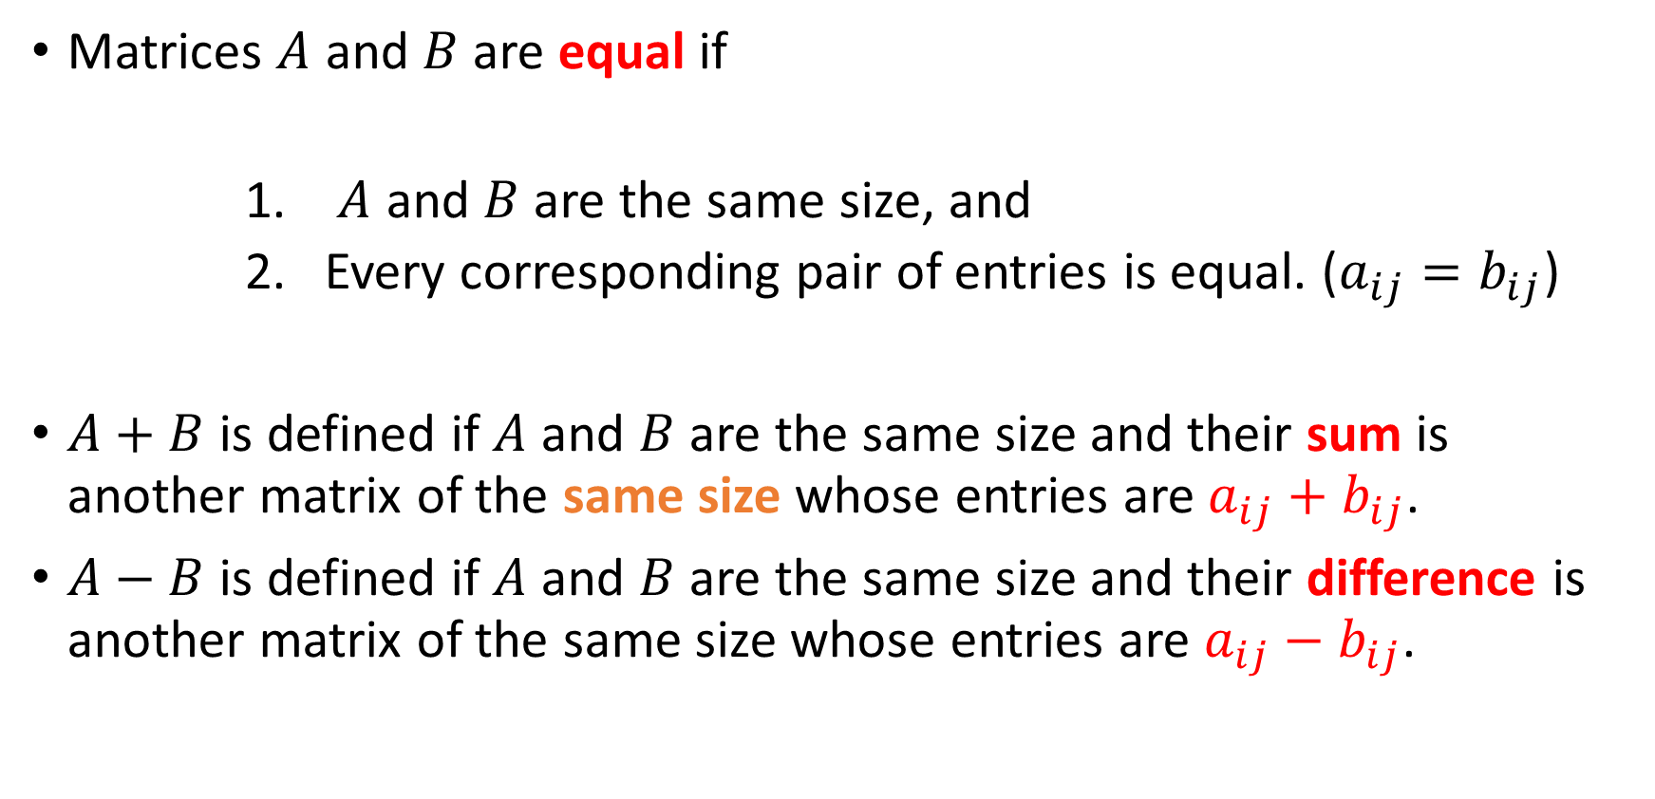
Equality, Addition, and Subtraction of Matrices
Matrices $A$ and $B$ are equal if
$A$ and $B$ are the same size, and
Every corresponding pair of entries is equal. ($a_{ij}=b_{ij}$)
$A+B$ is defined if $A$ and $B$ are the same size and their sum is another matrix of the same size whose entries are $a_{ij}+b_{ij}$.
$A−B$ is defined if $A$ and $B$ are the same size and their difference is another matrix of the same size whose entries are $a_{ij}−b_{ij}$.

Slide 4

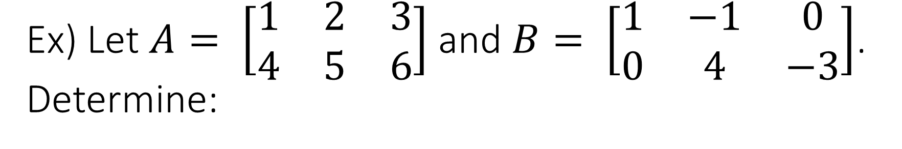
Ex) Let $A= \left[\begin{matrix}1 & 2 & 3 \\ 4 & 5 & 6\end{matrix}\right]$ and $B= \left[\begin{matrix}1 & −1 & 0 \\ 0 & 4 & −3\end{matrix}\right]$. Determine:
If $A=B$.
$A+B$ if it exists.
$A −B$ if it exists.

Slide 5

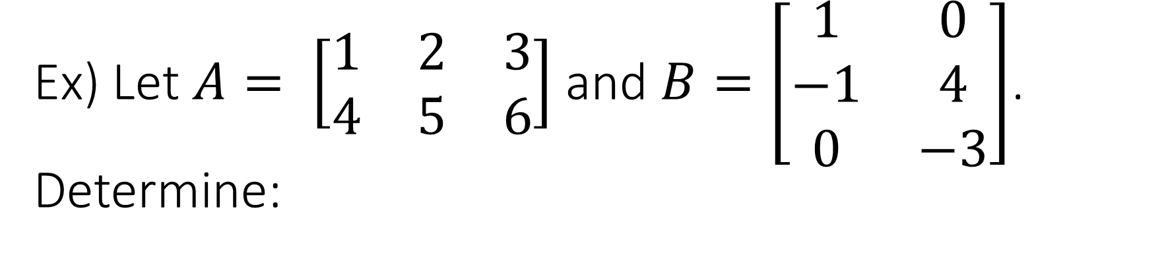
Ex) Let $A= \left[\begin{matrix}1 & 2 & 3 \\ 4 & 5 & 6\end{matrix}\right]$ and $B=\left[\begin{matrix}1 & 0 \\ −1 & 4 \\ 0 & −3\end{matrix}\right]$. Determine:
If $A=B$.
$A+B$ if it exists.
$A −B$ if it exists.

Slide 6
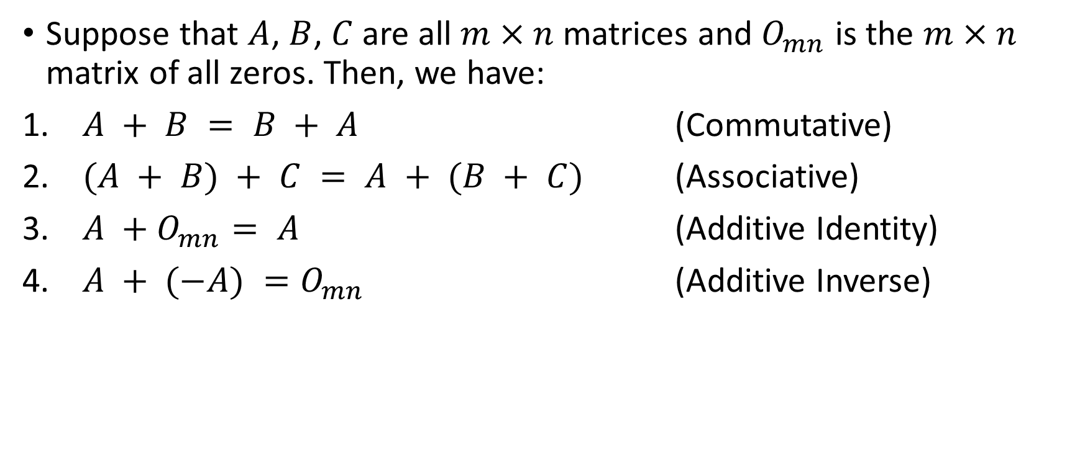
Algebraic Properties of Matrices
Suppose that $A$, $B$, $C$ are all $m×n$ matrices and $O_{mn}$ is the $m×n$ matrix of all zeros. Then, we have:
$A + B = B + A$ (Commutative)
$(A + B) + C = A + (B + C)$ (Associative)
$A +O_{mn}= A$ (Additive Identity)
$A + (−A) =O_{mn}$ (Additive Inverse)

Slide 7
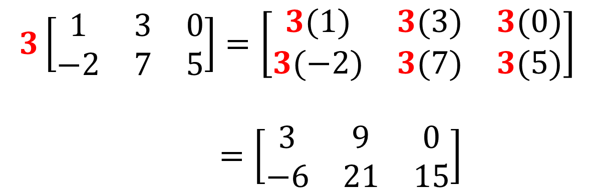
Scalar Multiplication
Like with vectors, a scalar is a real number that we multiply to all entries of the matrix:
$$3\left[\begin{matrix}1 & 3 & 0 \\ −2 & 7 & 5\end{matrix}\right]=\left[\begin{matrix}3(1) & 3(3) & 3(0) \\ 3(−2) & 3(7) & 3(5)\end{matrix}\right]$$ $=\left[\begin{matrix}3 & 9 & 0 \\ −6 & 21 & 15\end{matrix}\right]$

Slide 8

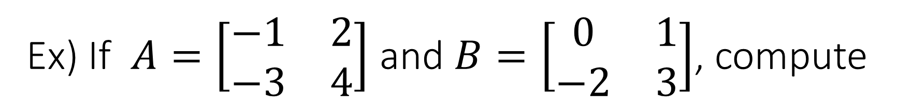
Ex) If $A=\left[\begin{matrix}−1 & 2 \\ −3 & 4\end{matrix}\right]$ and $B=\left[\begin{matrix}0 & 1 \\ −2 & 3\end{matrix}\right]$, compute
$2B −5A$

Slide 9


Matrix Multiplication
Perhaps you are asked to multiply two matrices together. What does it mean to multiply two matrices together?
If $A$ is $m×n$ and $B$ is $n×p$, then the product $AB$ is possible.
The size of $AB$ will be $m×p$.
$A$ $×$ $B$ $m×n$ $n×p$
MUST be equal
The order of AB is
determined by these two

Slide 10
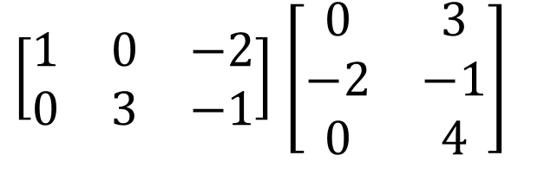
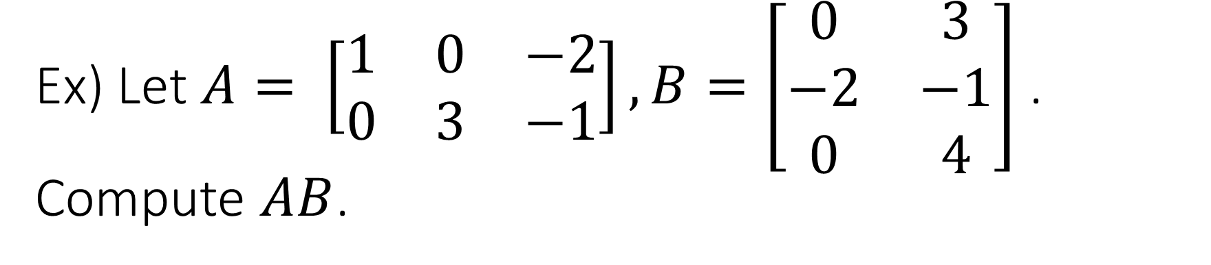
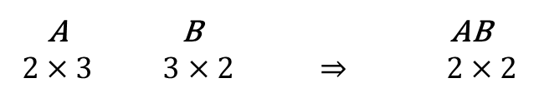
Ex) Let $A= \left[\begin{matrix}1 & 0 & −2 \\ 0 & 3 & −1\end{matrix}\right], B=\left[\begin{matrix}0 & 3 \\ −2 & −1 \\ 0 & 4\end{matrix}\right]$. Compute $AB$.
A B AB
$$2×3 3×2 ⇒ 2×2$$
$\left[\begin{matrix}1 & 0 & −2 \\ 0 & 3 & −1\end{matrix}\right]$ $\left[\begin{matrix}0 & 3 \\ −2 & −1 \\ 0 & 4\end{matrix}\right]$
$$=\left[\begin{matrix}\left(1\right)\left(0\right)+0\left(−2\right)+(−2)(0) \\ \left(0\right)\left(0\right)+\left(3\right)\left(−2\right)+(−1)(0)\end{matrix}\begin{matrix} \left(1\right)\left(3\right)+\left(0\right)\left(−1\right)+(−2)(4) \\ \left(0\right)\left(3\right)+\left(3\right)\left(−1\right)+(−1)(4)\end{matrix}\right]$$

Slide 11
Ex) Let $A= \left[\begin{matrix}1 & 0 & −2 \\ 0 & 3 & −1\end{matrix}\right], B=\left[\begin{matrix}0 & 3 \\ −2 & −1 \\ 0 & 4\end{matrix}\right]$. Compute $AB$.
A B AB
$$2×3 3×2 ⇒ 2×2$$
$\left[\begin{matrix}1 & 0 & −2 \\ 0 & 3 & −1\end{matrix}\right]$ $\left[\begin{matrix}0 & 3 \\ −2 & −1 \\ 0 & 4\end{matrix}\right]$
$$=\left[\begin{matrix}\left(1\right)\left(0\right)+0\left(−2\right)+(−2)(0) \\ \left(0\right)\left(0\right)+\left(3\right)\left(−2\right)+(−1)(0)\end{matrix}\begin{matrix} \left(1\right)\left(3\right)+\left(0\right)\left(−1\right)+(−2)(4) \\ \left(0\right)\left(3\right)+\left(3\right)\left(−1\right)+(−1)(4)\end{matrix}\right]$$

Slide 12
Ex) Let $A= \left[\begin{matrix}1 & 0 & −2 \\ 0 & 3 & −1\end{matrix}\right], B=\left[\begin{matrix}0 & 3 \\ −2 & −1 \\ 0 & 4\end{matrix}\right]$. Compute $AB$.
A B AB
$$2×3 3×2 ⇒ 2×2$$
$\left[\begin{matrix}1 & 0 & −2 \\ 0 & 3 & −1\end{matrix}\right]$ $\left[\begin{matrix}0 & 3 \\ −2 & −1 \\ 0 & 4\end{matrix}\right]$
$$=\left[\begin{matrix}\left(1\right)\left(0\right)+0\left(−2\right)+(−2)(0) \\ \left(0\right)\left(0\right)+\left(3\right)\left(−2\right)+(−1)(0)\end{matrix}\begin{matrix} \left(1\right)\left(3\right)+\left(0\right)\left(−1\right)+(−2)(4) \\ \left(0\right)\left(3\right)+\left(3\right)\left(−1\right)+(−1)(4)\end{matrix}\right]$$

Slide 13
Ex) Let $A= \left[\begin{matrix}1 & 0 & −2 \\ 0 & 3 & −1\end{matrix}\right], B=\left[\begin{matrix}0 & 3 \\ −2 & −1 \\ 0 & 4\end{matrix}\right]$. Compute $AB$.
A B AB
$$2×3 3×2 ⇒ 2×2$$
$\left[\begin{matrix}1 & 0 & −2 \\ 0 & 3 & −1\end{matrix}\right]$ $\left[\begin{matrix}0 & 3 \\ −2 & −1 \\ 0 & 4\end{matrix}\right]$
$$=\left[\begin{matrix}\left(1\right)\left(0\right)+0\left(−2\right)+(−2)(0) \\ \left(0\right)\left(0\right)+\left(3\right)\left(−2\right)+(−1)(0)\end{matrix}\begin{matrix} \left(1\right)\left(3\right)+\left(0\right)\left(−1\right)+(−2)(4) \\ \left(0\right)\left(3\right)+\left(3\right)\left(−1\right)+(−1)(4)\end{matrix}\right]$$

Slide 14
Ex) Let $A= \left[\begin{matrix}1 & 0 & −2 \\ 0 & 3 & −1\end{matrix}\right], B=\left[\begin{matrix}0 & 3 \\ −2 & −1 \\ 0 & 4\end{matrix}\right]$. Compute $AB$.
A B AB
$$2×3 3×2 ⇒ 2×2$$
$\left[\begin{matrix}1 & 0 & −2 \\ 0 & 3 & −1\end{matrix}\right]$ $\left[\begin{matrix}0 & 3 \\ −2 & −1 \\ 0 & 4\end{matrix}\right]$
$$=\left[\begin{matrix}\left(1\right)\left(0\right)+0\left(−2\right)+(−2)(0) \\ \left(0\right)\left(0\right)+\left(3\right)\left(−2\right)+(−1)(0)\end{matrix}\begin{matrix} \left(1\right)\left(3\right)+\left(0\right)\left(−1\right)+(−2)(4) \\ \left(0\right)\left(3\right)+\left(3\right)\left(−1\right)+(−1)(4)\end{matrix}\right]$$

Slide 15
Ex) Let $A= \left[\begin{matrix}1 & 0 & −2 \\ 0 & 3 & −1\end{matrix}\right], B=\left[\begin{matrix}0 & 3 \\ −2 & −1 \\ 0 & 4\end{matrix}\right]$. Compute $AB$.
A B AB
$$2×3 3×2 ⇒ 2×2$$
$\left[\begin{matrix}1 & 0 & −2 \\ 0 & 3 & −1\end{matrix}\right]$ $\left[\begin{matrix}0 & 3 \\ −2 & −1 \\ 0 & 4\end{matrix}\right]$
$$=\left[\begin{matrix}\left(1\right)\left(0\right)+0\left(−2\right)+(−2)(0) \\ \left(0\right)\left(0\right)+\left(3\right)\left(−2\right)+(−1)(0)\end{matrix}\begin{matrix} \left(1\right)\left(3\right)+\left(0\right)\left(−1\right)+(−2)(4) \\ \left(0\right)\left(3\right)+\left(3\right)\left(−1\right)+(−1)(4)\end{matrix}\right]$$

Slide 16
Ex) Let $A= \left[\begin{matrix}1 & 0 & −2 \\ 0 & 3 & −1\end{matrix}\right], B=\left[\begin{matrix}0 & 3 \\ −2 & −1 \\ 0 & 4\end{matrix}\right]$. Compute $AB$.
A B AB
$$2×3 3×2 ⇒ 2×2$$
$\left[\begin{matrix}1 & 0 & −2 \\ 0 & 3 & −1\end{matrix}\right]$ $\left[\begin{matrix}0 & 3 \\ −2 & −1 \\ 0 & 4\end{matrix}\right]$
$$=\left[\begin{matrix}\left(1\right)\left(0\right)+0\left(−2\right)+(−2)(0) \\ \left(0\right)\left(0\right)+\left(3\right)\left(−2\right)+(−1)(0)\end{matrix}\begin{matrix} \left(1\right)\left(3\right)+\left(0\right)\left(−1\right)+(−2)(4) \\ \left(0\right)\left(3\right)+\left(3\right)\left(−1\right)+(−1)(4)\end{matrix}\right]$$

Slide 17
Ex) Let $A= \left[\begin{matrix}1 & 0 & −2 \\ 0 & 3 & −1\end{matrix}\right], B=\left[\begin{matrix}0 & 3 \\ −2 & −1 \\ 0 & 4\end{matrix}\right]$. Compute $AB$.
A B AB
$$2×3 3×2 ⇒ 2×2$$
$\left[\begin{matrix}1 & 0 & −2 \\ 0 & 3 & −1\end{matrix}\right]$ $\left[\begin{matrix}0 & 3 \\ −2 & −1 \\ 0 & 4\end{matrix}\right]$
$$=\left[\begin{matrix}\left(1\right)\left(0\right)+0\left(−2\right)+(−2)(0) \\ \left(0\right)\left(0\right)+\left(3\right)\left(−2\right)+(−1)(0)\end{matrix}\begin{matrix} \left(1\right)\left(3\right)+\left(0\right)\left(−1\right)+(−2)(4) \\ \left(0\right)\left(3\right)+\left(3\right)\left(−1\right)+(−1)(4)\end{matrix}\right]$$

Slide 18
Ex) Let $A= \left[\begin{matrix}1 & 0 & −2 \\ 0 & 3 & −1\end{matrix}\right], B=\left[\begin{matrix}0 & 3 \\ −2 & −1 \\ 0 & 4\end{matrix}\right]$. Compute $AB$.
A B AB
$$2×3 3×2 ⇒ 2×2$$
$\left[\begin{matrix}1 & 0 & −2 \\ 0 & 3 & −1\end{matrix}\right]$ $\left[\begin{matrix}0 & 3 \\ −2 & −1 \\ 0 & 4\end{matrix}\right]$
$$=\left[\begin{matrix}\left(1\right)\left(0\right)+0\left(−2\right)+(−2)(0) \\ \left(0\right)\left(0\right)+\left(3\right)\left(−2\right)+(−1)(0)\end{matrix}\begin{matrix} \left(1\right)\left(3\right)+\left(0\right)\left(−1\right)+(−2)(4) \\ \left(0\right)\left(3\right)+\left(3\right)\left(−1\right)+(−1)(4)\end{matrix}\right]$$

Slide 19
Ex) Let $A= \left[\begin{matrix}1 & 0 & −2 \\ 0 & 3 & −1\end{matrix}\right], B=\left[\begin{matrix}0 & 3 \\ −2 & −1 \\ 0 & 4\end{matrix}\right]$. Compute $AB$.
A B AB
$$2×3 3×2 ⇒ 2×2$$
$\left[\begin{matrix}1 & 0 & −2 \\ 0 & 3 & −1\end{matrix}\right]$ $\left[\begin{matrix}0 & 3 \\ −2 & −1 \\ 0 & 4\end{matrix}\right]$
$$=\left[\begin{matrix}\left(1\right)\left(0\right)+0\left(−2\right)+(−2)(0) \\ \left(0\right)\left(0\right)+\left(3\right)\left(−2\right)+(−1)(0)\end{matrix}\begin{matrix} \left(1\right)\left(3\right)+\left(0\right)\left(−1\right)+(−2)(4) \\ \left(0\right)\left(3\right)+\left(3\right)\left(−1\right)+(−1)(4)\end{matrix}\right]$$

Slide 20
Ex) Let $A= \left[\begin{matrix}1 & 0 & −2 \\ 0 & 3 & −1\end{matrix}\right], B=\left[\begin{matrix}0 & 3 \\ −2 & −1 \\ 0 & 4\end{matrix}\right]$. Compute $AB$.
A B AB
$$2×3 3×2 ⇒ 2×2$$
$\left[\begin{matrix}1 & 0 & −2 \\ 0 & 3 & −1\end{matrix}\right]$ $\left[\begin{matrix}0 & 3 \\ −2 & −1 \\ 0 & 4\end{matrix}\right]$
$$=\left[\begin{matrix}\left(1\right)\left(0\right)+0\left(−2\right)+(−2)(0) \\ \left(0\right)\left(0\right)+\left(3\right)\left(−2\right)+(−1)(0)\end{matrix}\begin{matrix} \left(1\right)\left(3\right)+\left(0\right)\left(−1\right)+(−2)(4) \\ \left(0\right)\left(3\right)+\left(3\right)\left(−1\right)+(−1)(4)\end{matrix}\right]$$

Slide 21
Ex) Let $A= \left[\begin{matrix}1 & 0 & −2 \\ 0 & 3 & −1\end{matrix}\right], B=\left[\begin{matrix}0 & 3 \\ −2 & −1 \\ 0 & 4\end{matrix}\right]$. Compute $AB$.
A B AB
$$2×3 3×2 ⇒ 2×2$$
$\left[\begin{matrix}1 & 0 & −2 \\ 0 & 3 & −1\end{matrix}\right]$ $\left[\begin{matrix}0 & 3 \\ −2 & −1 \\ 0 & 4\end{matrix}\right]$
$$=\left[\begin{matrix}\left(1\right)\left(0\right)+0\left(−2\right)+(−2)(0) \\ \left(0\right)\left(0\right)+\left(3\right)\left(−2\right)+(−1)(0)\end{matrix}\begin{matrix} \left(1\right)\left(3\right)+\left(0\right)\left(−1\right)+(−2)(4) \\ \left(0\right)\left(3\right)+\left(3\right)\left(−1\right)+(−1)(4)\end{matrix}\right]$$

Slide 22
Ex) Let $A= \left[\begin{matrix}1 & 0 & −2 \\ 0 & 3 & −1\end{matrix}\right], B=\left[\begin{matrix}0 & 3 \\ −2 & −1 \\ 0 & 4\end{matrix}\right]$. Compute $AB$.
A B AB
$$2×3 3×2 ⇒ 2×2$$
$\left[\begin{matrix}1 & 0 & −2 \\ 0 & 3 & −1\end{matrix}\right]$ $\left[\begin{matrix}0 & 3 \\ −2 & −1 \\ 0 & 4\end{matrix}\right]$
$$=\left[\begin{matrix}\left(1\right)\left(0\right)+0\left(−2\right)+(−2)(0) \\ \left(0\right)\left(0\right)+\left(3\right)\left(−2\right)+(−1)(0)\end{matrix}\begin{matrix} \left(1\right)\left(3\right)+\left(0\right)\left(−1\right)+(−2)(4) \\ \left(0\right)\left(3\right)+\left(3\right)\left(−1\right)+(−1)(4)\end{matrix}\right]$$

Slide 23
Ex) Let $A= \left[\begin{matrix}1 & 0 & −2 \\ 0 & 3 & −1\end{matrix}\right], B=\left[\begin{matrix}0 & 3 \\ −2 & −1 \\ 0 & 4\end{matrix}\right]$. Compute $AB$.
A B AB
$$2×3 3×2 ⇒ 2×2$$
$\left[\begin{matrix}1 & 0 & −2 \\ 0 & 3 & −1\end{matrix}\right]$ $\left[\begin{matrix}0 & 3 \\ −2 & −1 \\ 0 & 4\end{matrix}\right]$
$$=\left[\begin{matrix}\left(1\right)\left(0\right)+0\left(−2\right)+(−2)(0) \\ \left(0\right)\left(0\right)+\left(3\right)\left(−2\right)+(−1)(0)\end{matrix}\begin{matrix} \left(1\right)\left(3\right)+\left(0\right)\left(−1\right)+(−2)(4) \\ \left(0\right)\left(3\right)+\left(3\right)\left(−1\right)+(−1)(4)\end{matrix}\right]$$

Slide 24
Ex) Let $A= \left[\begin{matrix}1 & 0 & −2 \\ 0 & 3 & −1\end{matrix}\right], B=\left[\begin{matrix}0 & 3 \\ −2 & −1 \\ 0 & 4\end{matrix}\right]$. Compute $AB$.
A B AB
$$2×3 3×2 ⇒ 2×2$$
$\left[\begin{matrix}1 & 0 & −2 \\ 0 & 3 & −1\end{matrix}\right]$ $\left[\begin{matrix}0 & 3 \\ −2 & −1 \\ 0 & 4\end{matrix}\right]$
$$=\left[\begin{matrix}\left(1\right)\left(0\right)+0\left(−2\right)+(−2)(0) \\ \left(0\right)\left(0\right)+\left(3\right)\left(−2\right)+(−1)(0)\end{matrix}\begin{matrix} \left(1\right)\left(3\right)+\left(0\right)\left(−1\right)+(−2)(4) \\ \left(0\right)\left(3\right)+\left(3\right)\left(−1\right)+(−1)(4)\end{matrix}\right]$$

Slide 25
Ex) Let $A= \left[\begin{matrix}1 & 0 & −2 \\ 0 & 3 & −1\end{matrix}\right], B=\left[\begin{matrix}0 & 3 \\ −2 & −1 \\ 0 & 4\end{matrix}\right]$. Compute $AB$.
A B AB
$$2×3 3×2 ⇒ 2×2$$
$\left[\begin{matrix}1 & 0 & −2 \\ 0 & 3 & −1\end{matrix}\right]$ $\left[\begin{matrix}0 & 3 \\ −2 & −1 \\ 0 & 4\end{matrix}\right]$
$$=\left[\begin{matrix}\left(1\right)\left(0\right)+0\left(−2\right)+(−2)(0) \\ \left(0\right)\left(0\right)+\left(3\right)\left(−2\right)+(−1)(0)\end{matrix}\begin{matrix} \left(1\right)\left(3\right)+\left(0\right)\left(−1\right)+(−2)(4) \\ \left(0\right)\left(3\right)+\left(3\right)\left(−1\right)+(−1)(4)\end{matrix}\right]$$

Slide 26
Ex) Let $A= \left[\begin{matrix}1 & 0 & −2 \\ 0 & 3 & −1\end{matrix}\right], B=\left[\begin{matrix}0 & 3 \\ −2 & −1 \\ 0 & 4\end{matrix}\right]$. Compute $AB$.
A B AB
$$2×3 3×2 ⇒ 2×2$$
$\left[\begin{matrix}1 & 0 & −2 \\ 0 & 3 & −1\end{matrix}\right]$ $\left[\begin{matrix}0 & 3 \\ −2 & −1 \\ 0 & 4\end{matrix}\right]$
$$=\left[\begin{matrix}\left(1\right)\left(0\right)+0\left(−2\right)+(−2)(0) \\ \left(0\right)\left(0\right)+\left(3\right)\left(−2\right)+(−1)(0)\end{matrix}\begin{matrix} \left(1\right)\left(3\right)+\left(0\right)\left(−1\right)+(−2)(4) \\ \left(0\right)\left(3\right)+\left(3\right)\left(−1\right)+(−1)(4)\end{matrix}\right]$$

Slide 27
Ex) Let $A= \left[\begin{matrix}1 & 0 & −2 \\ 0 & 3 & −1\end{matrix}\right], B=\left[\begin{matrix}0 & 3 \\ −2 & −1 \\ 0 & 4\end{matrix}\right]$. Compute $AB$.
A B AB
$$2×3 3×2 ⇒ 2×2$$
$\left[\begin{matrix}1 & 0 & −2 \\ 0 & 3 & −1\end{matrix}\right]$ $\left[\begin{matrix}0 & 3 \\ −2 & −1 \\ 0 & 4\end{matrix}\right]$
$$=\left[\begin{matrix}\left(1\right)\left(0\right)+0\left(−2\right)+(−2)(0) \\ \left(0\right)\left(0\right)+\left(3\right)\left(−2\right)+(−1)(0)\end{matrix}\begin{matrix} \left(1\right)\left(3\right)+\left(0\right)\left(−1\right)+(−2)(4) \\ \left(0\right)\left(3\right)+\left(3\right)\left(−1\right)+(−1)(4)\end{matrix}\right]$$

Slide 28
Ex) Let $A= \left[\begin{matrix}1 & 0 & −2 \\ 0 & 3 & −1\end{matrix}\right], B=\left[\begin{matrix}0 & 3 \\ −2 & −1 \\ 0 & 4\end{matrix}\right]$. Compute $AB$.
A B AB
$$2×3 3×2 ⇒ 2×2$$
$\left[\begin{matrix}1 & 0 & −2 \\ 0 & 3 & −1\end{matrix}\right]$ $\left[\begin{matrix}0 & 3 \\ −2 & −1 \\ 0 & 4\end{matrix}\right]$
$$=\left[\begin{matrix}\left(1\right)\left(0\right)+0\left(−2\right)+(−2)(0) \\ \left(0\right)\left(0\right)+\left(3\right)\left(−2\right)+(−1)(0)\end{matrix}\begin{matrix} \left(1\right)\left(3\right)+\left(0\right)\left(−1\right)+(−2)(4) \\ \left(0\right)\left(3\right)+\left(3\right)\left(−1\right)+(−1)(4)\end{matrix}\right]$$

Slide 29
Ex) Let $A= \left[\begin{matrix}1 & 0 & −2 \\ 0 & 3 & −1\end{matrix}\right], B=\left[\begin{matrix}0 & 3 \\ −2 & −1 \\ 0 & 4\end{matrix}\right]$. Compute $AB$.
A B AB
$$2×3 3×2 ⇒ 2×2$$
$\left[\begin{matrix}1 & 0 & −2 \\ 0 & 3 & −1\end{matrix}\right]$ $\left[\begin{matrix}0 & 3 \\ −2 & −1 \\ 0 & 4\end{matrix}\right]$
$$=\left[\begin{matrix}\left(1\right)\left(0\right)+0\left(−2\right)+(−2)(0) \\ \left(0\right)\left(0\right)+\left(3\right)\left(−2\right)+(−1)(0)\end{matrix}\begin{matrix} \left(1\right)\left(3\right)+\left(0\right)\left(−1\right)+(−2)(4) \\ \left(0\right)\left(3\right)+\left(3\right)\left(−1\right)+(−1)(4)\end{matrix}\right]$$

Slide 30
Ex) Let $A= \left[\begin{matrix}1 & 0 & −2 \\ 0 & 3 & −1\end{matrix}\right], B=\left[\begin{matrix}0 & 3 \\ −2 & −1 \\ 0 & 4\end{matrix}\right]$. Compute $AB$.
A B AB
$$2×3 3×2 ⇒ 2×2$$
$\left[\begin{matrix}1 & 0 & −2 \\ 0 & 3 & −1\end{matrix}\right]$ $\left[\begin{matrix}0 & 3 \\ −2 & −1 \\ 0 & 4\end{matrix}\right]$
$$=\left[\begin{matrix}\left(1\right)\left(0\right)+0\left(−2\right)+(−2)(0) \\ \left(0\right)\left(0\right)+\left(3\right)\left(−2\right)+(−1)(0)\end{matrix}\begin{matrix} \left(1\right)\left(3\right)+\left(0\right)\left(−1\right)+(−2)(4) \\ \left(0\right)\left(3\right)+\left(3\right)\left(−1\right)+(−1)(4)\end{matrix}\right]$$

Slide 31
Ex) Let $A= \left[\begin{matrix}1 & 0 & −2 \\ 0 & 3 & −1\end{matrix}\right], B=\left[\begin{matrix}0 & 3 \\ −2 & −1 \\ 0 & 4\end{matrix}\right]$. Compute $AB$.
A B AB
$$2×3 3×2 ⇒ 2×2$$
$\left[\begin{matrix}1 & 0 & −2 \\ 0 & 3 & −1\end{matrix}\right]$ $\left[\begin{matrix}0 & 3 \\ −2 & −1 \\ 0 & 4\end{matrix}\right]$
$$=\left[\begin{matrix}\left(1\right)\left(0\right)+0\left(−2\right)+(−2)(0) \\ \left(0\right)\left(0\right)+\left(3\right)\left(−2\right)+(−1)(0)\end{matrix}\begin{matrix} \left(1\right)\left(3\right)+\left(0\right)\left(−1\right)+(−2)(4) \\ \left(0\right)\left(3\right)+\left(3\right)\left(−1\right)+(−1)(4)\end{matrix}\right]$$

Slide 32
Ex) Let $A= \left[\begin{matrix}1 & 0 & −2 \\ 0 & 3 & −1\end{matrix}\right], B=\left[\begin{matrix}0 & 3 \\ −2 & −1 \\ 0 & 4\end{matrix}\right]$. Compute $AB$.
A B AB
$$2×3 3×2 ⇒ 2×2$$
$\left[\begin{matrix}1 & 0 & −2 \\ 0 & 3 & −1\end{matrix}\right]$ $\left[\begin{matrix}0 & 3 \\ −2 & −1 \\ 0 & 4\end{matrix}\right]$
$$=\left[\begin{matrix}\left(1\right)\left(0\right)+0\left(−2\right)+(−2)(0) \\ \left(0\right)\left(0\right)+\left(3\right)\left(−2\right)+(−1)(0)\end{matrix}\begin{matrix} \left(1\right)\left(3\right)+\left(0\right)\left(−1\right)+(−2)(4) \\ \left(0\right)\left(3\right)+\left(3\right)\left(−1\right)+(−1)(4)\end{matrix}\right]$$

Slide 33
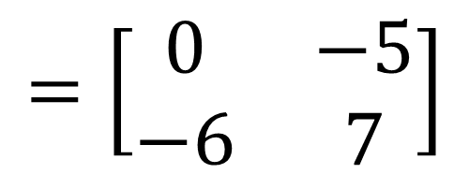
Ex) Let $A= \left[\begin{matrix}1 & 0 & −2 \\ 0 & 3 & −1\end{matrix}\right], B=\left[\begin{matrix}0 & 3 \\ −2 & −1 \\ 0 & 4\end{matrix}\right]$. Compute $AB$.
A B AB
$$2×3 3×2 ⇒ 2×2$$
$\left[\begin{matrix}1 & 0 & −2 \\ 0 & 3 & −1\end{matrix}\right]$ $\left[\begin{matrix}0 & 3 \\ −2 & −1 \\ 0 & 4\end{matrix}\right]$
$$=\left[\begin{matrix}\left(1\right)\left(0\right)+0\left(−2\right)+(−2)(0) \\ \left(0\right)\left(0\right)+\left(3\right)\left(−2\right)+(−1)(0)\end{matrix}\begin{matrix} \left(1\right)\left(3\right)+\left(0\right)\left(−1\right)+(−2)(4) \\ \left(0\right)\left(3\right)+\left(3\right)\left(−1\right)+(−1)(4)\end{matrix}\right]$$
$$=\left[\begin{matrix}0 & −5 \\ −6 & 7\end{matrix}\right]$$

Slide 34

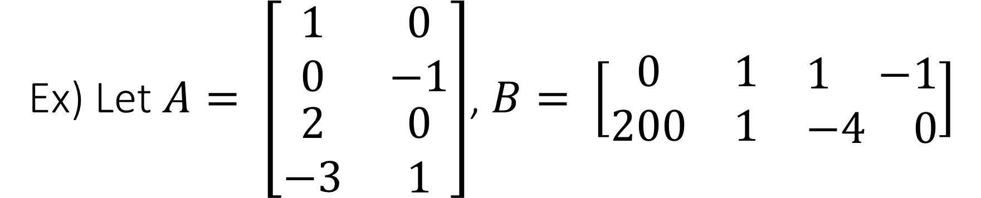
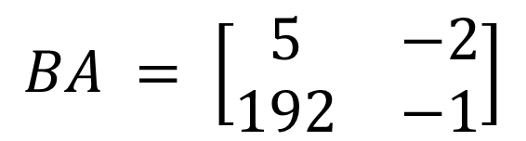

Ex) Let $A= \left[\begin{matrix}1 & 0 \\ 0 & −1 \\ \begin{matrix}2 \\ −3\end{matrix} & \begin{matrix}0 \\ 1\end{matrix}\end{matrix}\right]$, $B= \left[\begin{matrix}0 & 1 & \begin{matrix}1 & −1\end{matrix} \\ 200 & 1 & \begin{matrix}−4 & 0\end{matrix}\end{matrix}\right]$
Find the order of $AB$ and $BA$.
Compute $AB$ and $BA$ if possible.
$$AB = \left[\begin{matrix}0 & 1 & \begin{matrix}1 & −1\end{matrix} \\ −200 & −1 & \begin{matrix}4 & 0\end{matrix} \\ 0 & 2 & \begin{matrix}2 & −2\end{matrix} \\ 200 & −2 & \begin{matrix}−7 & 3\end{matrix}\end{matrix}\right]$$
$$BA = \left[\begin{matrix}5 & −2 \\ 192 & −1\end{matrix}\right]$$
NOTE: In general, $AB≠BA$. That is, matrix multiplication is NOT commutative.

Slide 35
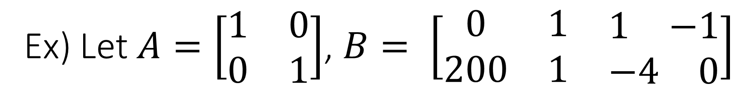

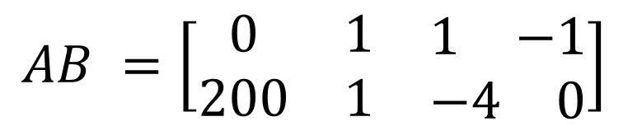
Ex) Let $A=\left[\begin{matrix}1 & 0 \\ 0 & 1\end{matrix}\right]$, $B= \left[\begin{matrix}0 & 1 & \begin{matrix}1 & −1\end{matrix} \\ 200 & 1 & \begin{matrix}−4 & 0\end{matrix}\end{matrix}\right]$
Find the order of $AB$ and $BA$.
Compute $AB$ and $BA$ if possible.
$$AB =\left[\begin{matrix}0 & 1 & \begin{matrix}1 & −1\end{matrix} \\ 200 & 1 & \begin{matrix}−4 & 0\end{matrix}\end{matrix}\right]$$
$BA$is impossible

Slide 36
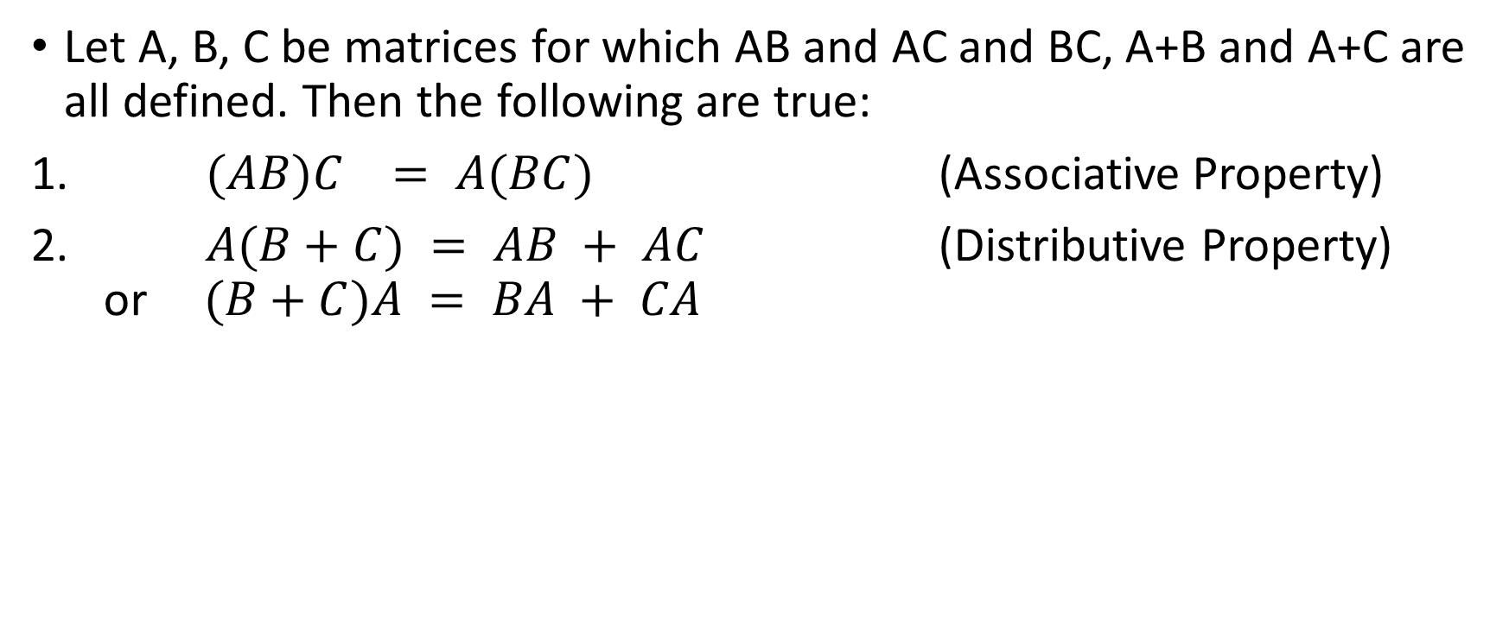
Properties of Matrix Multiplication
Let A, B, C be matrices for which AB and AC and BC, A+B and A+C are all defined. Then the following are true:
$(AB)C = A(BC)$ (Associative Property)
$A(B+C) = AB + AC$ (Distributive Property) or $(B+C)A = BA + CA$

